Slide 1
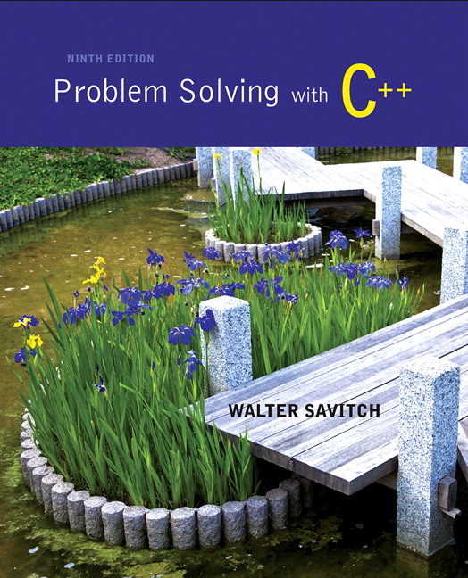
Problem Solving with C++ by Walter Savitch

Slide 2
Chapter 6
I/O Streams as an Introduction to Objects and Classes

Slide 3
Overview
6.1 Streams and Basic File I/O
6.2 Tools for Stream I/O
6.3 Character I/O

Slide 4
6.1
Streams and Basic File I/O

Slide 5
I/O Streams
I/O refers to program input and output
Input is delivered to your program via a stream object
Input can be from
The keyboard
A file
Output is delivered to the output device via a stream object
Output can be to
The screen
A file

Slide 6
Objects
Objects are special variables that
Have their own special-purpose functions
Set C++ apart from earlier programming languages

Slide 7
Streams and Basic File I/O
Files for I/O are the same type of files used to store programs
A stream is a flow of data.
Input stream: Data flows into the program
If input stream flows from keyboard, the program will accept data from the keyboard
If input stream flows from a file, the program will accept data from the file
Output stream: Data flows out of the program
To the screen
To a file

Slide 8
cin And cout Streams
cin
Input stream connected to the keyboard
cout
Output stream connected to the screen
cin and cout defined in the iostream library
Use include directive: #include <iostream>
You can declare your own streams to use with files.

Slide 9
Why Use Files?
Files allow you to store data permanently!
Data output to a file lasts after the program ends
An input file can be used over and over
No typing of data again and again for testing
Create a data file or read an output file at your convenience
Files allow you to deal with larger data sets

Slide 10
File I/O
Reading from a file
Taking input from a file
Done from beginning to the end (for now)
No backing up to read something again (OK to start over)
Just as done from the keyboard
Writing to a file
Sending output to a file
Done from beginning to end (for now)
No backing up to write something again( OK to start over)
Just as done to the screen

Slide 11
Stream Variables
Like other variables, a stream variable…
Must be declared before it can be used
Must be initialized before it contains valid data
Initializing a stream means connecting it to a file
The value of the stream variable can be thought of as the file it is connected to
Can have its value changed
Changing a stream value means disconnecting from one file and connecting to another

Slide 12
Streams and Assignment
A stream is a special kind of variable called an object
Objects can use special functions to complete tasks
Streams use special functions instead of the assignment operator to change values

Slide 13
Declaring An Input-file Stream Variable
Input-file streams are of type ifstream
Type ifstream is defined in the fstream library
You must use the include and using directives #include <fstream> using namespace std;
Declare an input-file stream variable using ifstream in_stream;

Slide 14
Declaring An Output-file Stream Variable
Ouput-file streams of are type ofstream
Type ofstream is defined in the fstream library
You must use these include and using directives #include <fstream> using namespace std;
Declare an input-file stream variable using ofstream out_stream;

Slide 15
Connecting To A File
Once a stream variable is declared, connect it to a file
Connecting a stream to a file is opening the file
Use the open function of the stream object
in_stream.open("infile.dat");
Double quotes
Period
File name on the disk

Slide 16
Using The Input Stream
Once connected to a file, the input-stream variable can be used to produce input just as you would use cin with the extraction operator
Example: int one_number, another_number; in_stream >> one_number >> another_number;

Slide 17
Using The Output Stream
An output-stream works similarly to the input-stream
ofstream out_stream; out_stream.open("outfile.dat"); out_stream << "one number = " << one_number << "another number = " << another_number;

Slide 18
External File Names
An External File Name…
Is the name for a file that the operating system uses
infile.dat and outfile.dat used in the previous examples
Is the "real", on-the-disk, name for a file
Needs to match the naming conventions on your system
Usually only used in the stream's open statement
Once open, referred to using the name of the stream connected to it.

Slide 19
Closing a File
After using a file, it should be closed
This disconnects the stream from the file
Close files to reduce the chance of a file being corrupted if the program terminates abnormally
It is important to close an output file if your program later needs to read input from the output file
The system will automatically close files if you forget as long as your program ends normally

Slide 20
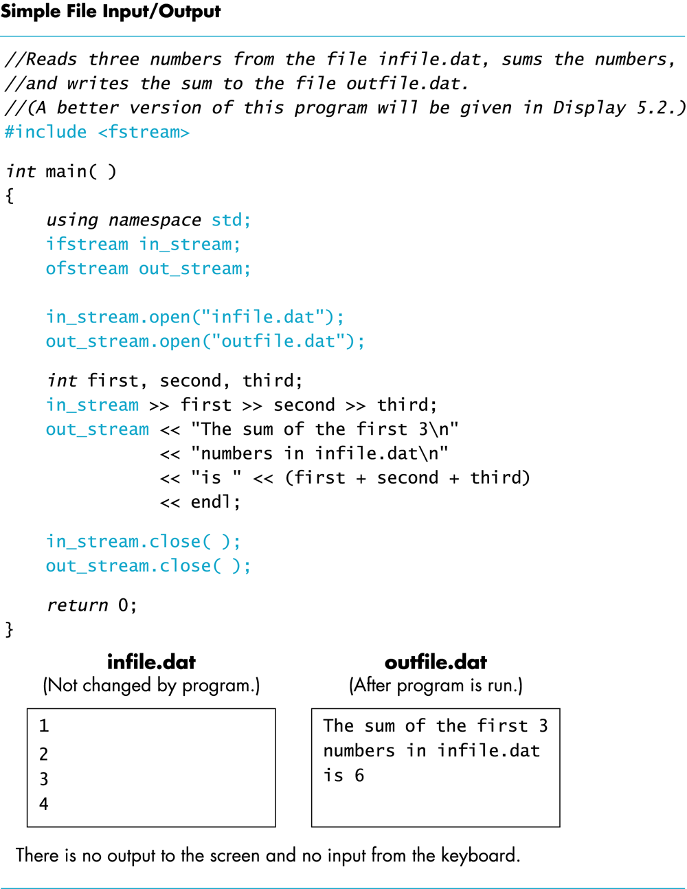
Display 6.1

Slide 21
Objects
An object is a variable that has functions and data associated with it
in_stream and out_stream each have a function named open associated with them
in_stream and out_stream use different versions of a function named open
One version of open is for input files
A different version of open is for output files

Slide 22
Member Functions
A member function is a function associated with an object
The open function is a member function of in_stream in the previous examples
A different open function is a member function of out_stream in the previous examples

Slide 23
Objects and Member Function Names
Objects of different types have different member functions
Some of these member functions might have the same name
Different objects of the same type have the same member functions

Slide 24
Classes
A type whose variables are objects, is a class
ifstream is the type of the in_stream variable (object)
ifstream is a class
The class of an object determines its member functions
Example: ifstream in_stream1, in_stream2;
in_stream1.open and in_stream2.open are the same function but might have different arguments

Slide 25
Class Member Functions
Member functions of an object are the member functions of its class
The class determines the member functions of the object
The class ifstream has an open function
Every variable (object) declared of type ifstream has that open function

Slide 26
Calling a Member Function
Calling a member function requires specifying the object containing the function
The calling object is separated from the member function by the dot operator
Example: in_stream.open("infile.dat");
Calling object
Member function
Dot operator

Slide 27
Member Function Calling Syntax
Syntax for calling a member function: Calling_object.Member_Function_Name(Argument_list);

Slide 28
Errors On Opening Files
Opening a file could fail for several reasons
Common reasons for open to fail include
The file might not exist
The name might be typed incorrectly
May be no error message if the call to open fails
Program execution continues!

Slide 29
Catching Stream Errors
Member function fail, can be used to test the success of a stream operation
fail returns a boolean type (true or false)
fail returns true if the stream operation failed

Slide 30
Halting Execution
When a stream open function fails, it is generally best to stop the program
The function exit, halts a program
exit returns its argument to the operating system
exit causes program execution to stop
exit is NOT a member function
Exit requires the include and using directives #include <cstdlib> using namespace std;

Slide 31
Using fail and exit
Immediately following the call to open, check that the operation was successful: in_stream.open("stuff.dat"); if( in_stream.fail( ) ) { cout << "Input file opening failed.\n"; exit(1) ; }

Slide 32
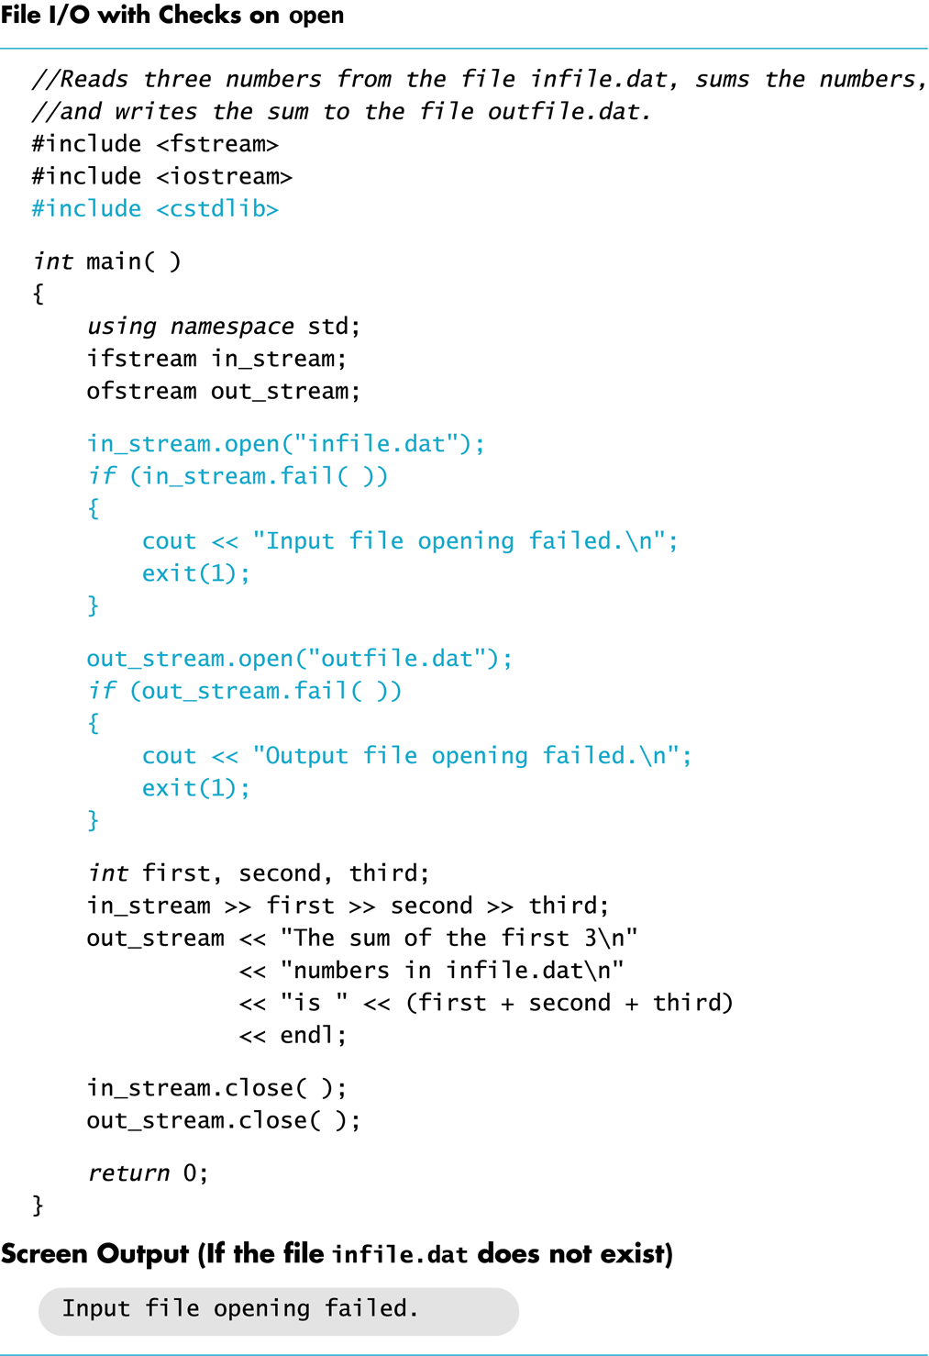
Display 6.2

Slide 33
Techniques for File I/O
When reading input from a file…
Do not include prompts or echo the input
The lines cout << "Enter the number: "; cin >> the_number; cout << "The number you entered is " << the_number; become just one line in_file >> the_number;
The input file must contain exactly the data expected

Slide 34
Appending Data (optional)
Output examples so far create new files
If the output file already contains data, that data is lost
To append new output to the end an existing file
use the constant ios::app defined in the iostream library: outStream.open("important.txt", ios::app);
If the file does not exist, a new file will be created

Slide 35
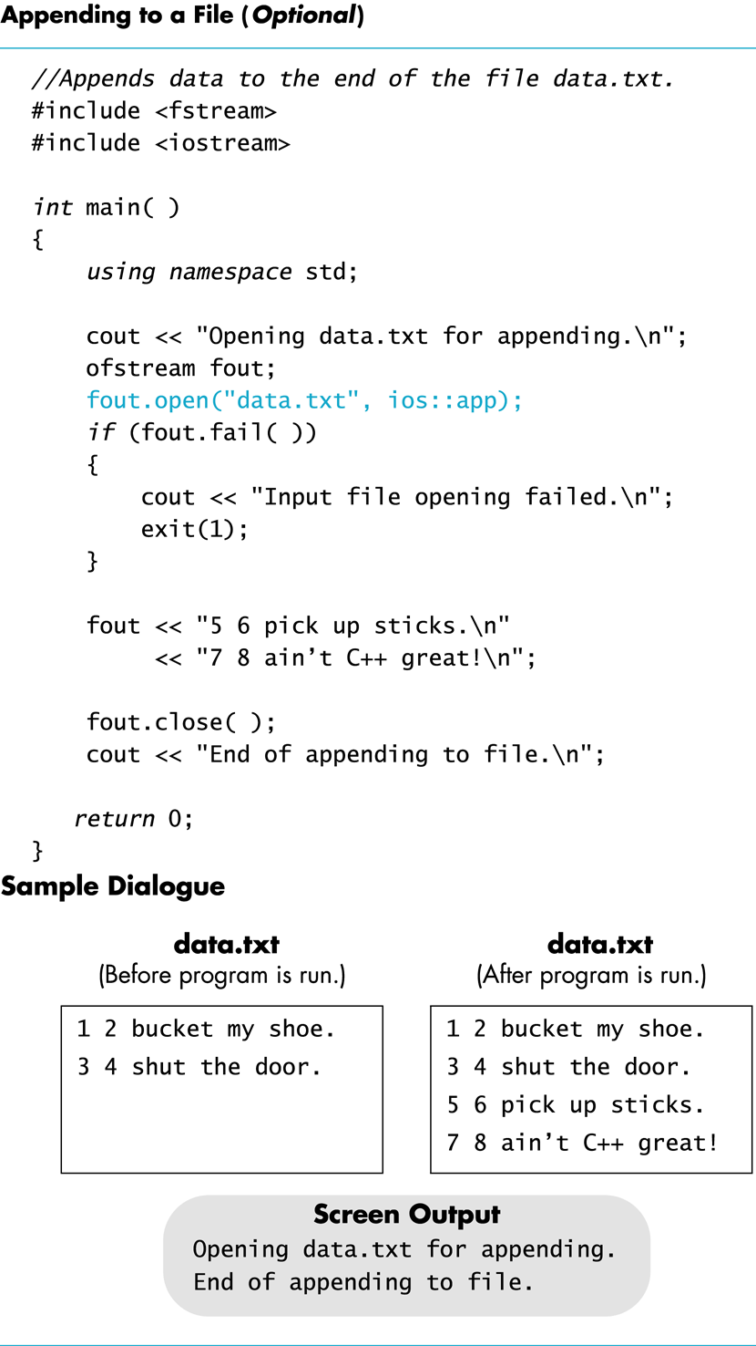
Display 6.3

Slide 36
File Names as Input (optional)
Program users can enter the name of a file to use for input or for output
Program must use a variable that can hold multiple characters
A sequence of characters is called a string
Declaring a variable to hold a string of characters: char file_name[16];
file_name is the name of a variable
Brackets enclose the maximum number of characters + 1
The variable file_name contains up to 15 characters

Slide 37
Using A Character String
char file_name[16]; cout << "Enter the file_name "; cin >> file_name; ifstream in_stream; in_stream.open(file_name); if (in_stream.fail( ) ) { cout << "Input file opening failed.\n"; exit(1); }

Slide 38
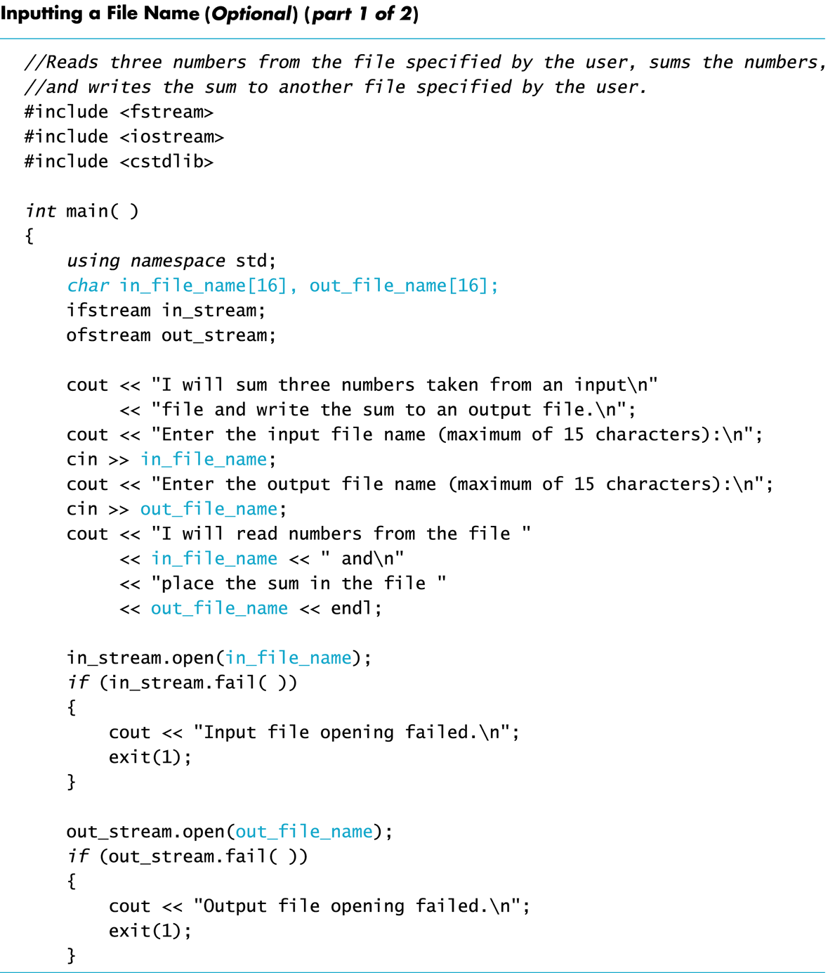
Display 6.4 (1/2)

Slide 39
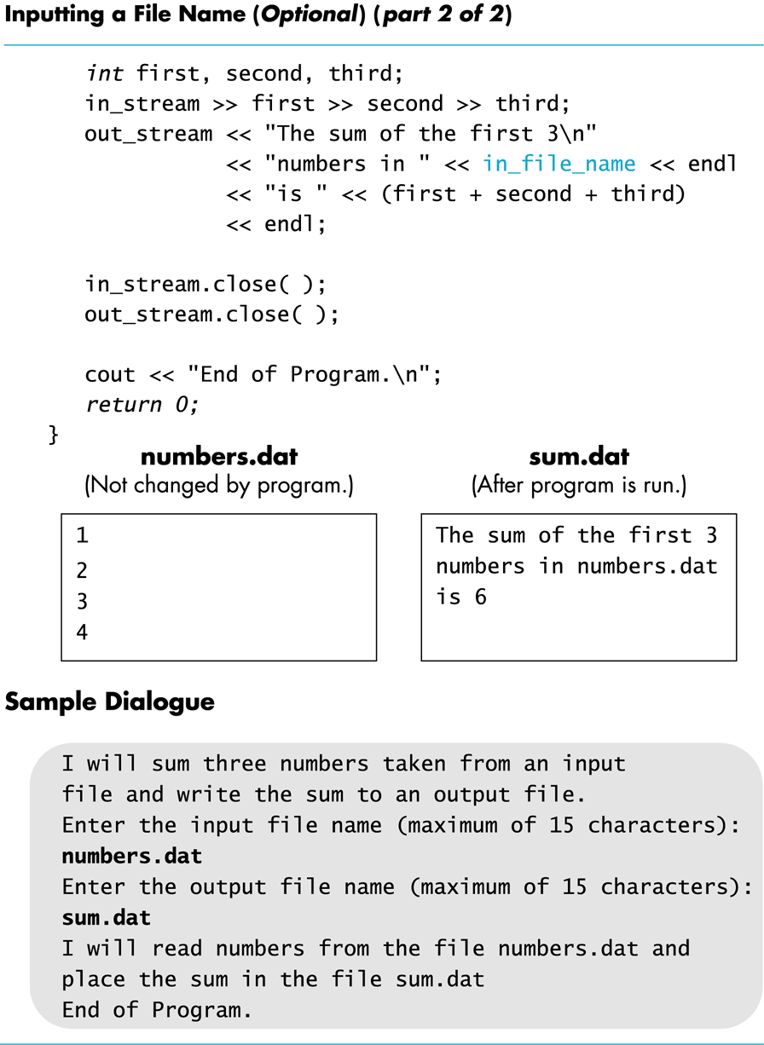
Display 6.4 (2/2)

Slide 40
Section 6.1 Conclusion
Can you
Write a program that uses a stream called fin which will be connected to an input file and a stream called fout which will be connected to an output file? How do you declare fin and fout? What include directive, if any, do you nee to place in your program file?
Name at least three member functions of an iostream object and give examples of usage of each?

Slide 41
6.2
Tools for Streams I/O

Slide 42
Tools for Stream I/O
To control the format of the program's output
We use commands that determine such details as:
The spaces between items
The number of digits after a decimal point
The numeric style: scientific notation for fixed point
Showing digits after a decimal point even if they are zeroes
Showing plus signs in front of positive numbers
Left or right justifying numbers in a given space

Slide 43
Formatting Output to Files
Format output to the screen with: cout.setf(ios::fixed); cout.setf(ios::showpoint); cout.precision(2);
Format output to a file using the out-file stream named out_stream with: out_stream.setf(ios::fixed); out_stream.setf(ios::showpoint); out_stream.precision(2);

Slide 44
out_stream.precision(2);
precision is a member function of output streams
After out_stream.precision(2); Output of numbers with decimal points…
will show a total of 2 significant digits 23. 2.2e7 2.2 6.9e-1 0.00069 OR
will show 2 digits after the decimal point 23.56 2.26e7 2.21 0.69 0.69e-4
Calls to precision apply only to the stream named in the call

Slide 45
setf(ios::fixed);
setf is a member function of output streams
setf is an abbreviation for set flags
A flag is an instruction to do one of two options
ios::fixed is a flag
After out_stream.setf(ios::fixed); All further output of floating point numbers…
Will be written in fixed-point notation, the way we normally expect to see numbers
Calls to setf apply only to the stream named in the call

Slide 46
setf(ios::showpoint);
After out_stream.setf(ios::showpoint); Output of floating point numbers…
Will show the decimal point even if all digits after the decimal point are zeroes

Slide 47
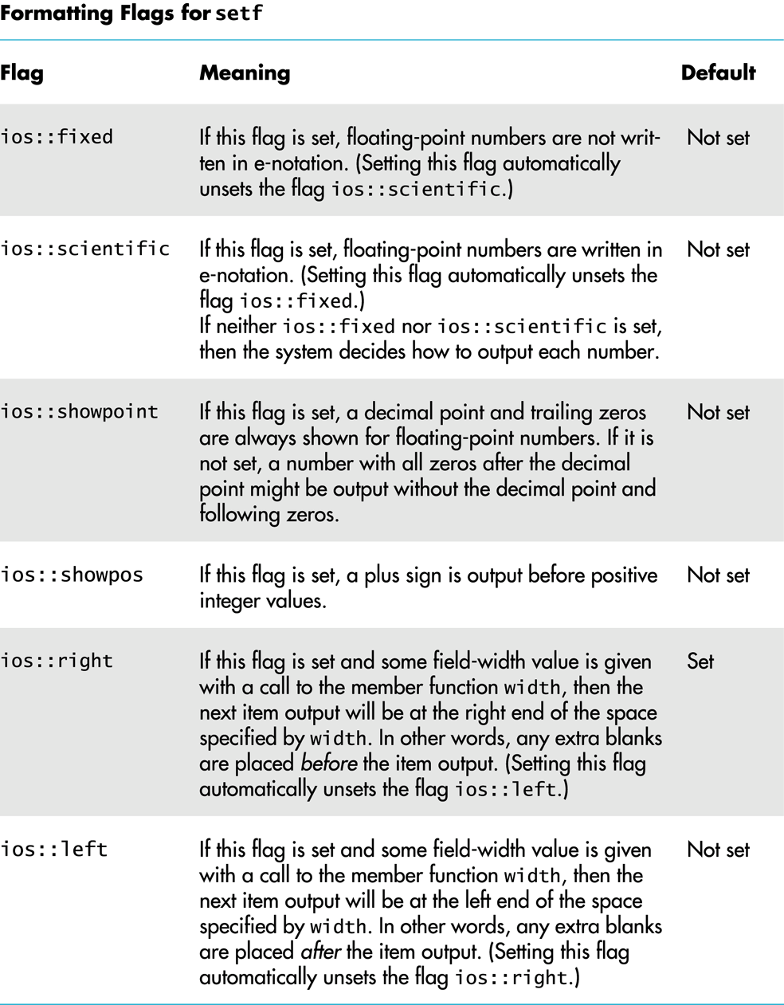
Display 6.5

Slide 48
Creating Space in Output
The width function specifies the number of spaces for the next item
Applies only to the next item of output
Example: To print the digit 7 in four spaces use out_stream.width(4); out_stream << 7 << endl;
Three of the spaces will be blank
7
7
(ios::right)
(ios::left)

Slide 49
Not Enough Width?
What if the argument for width is too small?
Such as specifying cout.width(3); when the value to print is 3456.45
The entire item is always output
If too few spaces are specified, as many more spaces as needed are used

Slide 50
Unsetting Flags
Any flag that is set, may be unset
Use the unsetf function
Example: cout.unsetf(ios::showpos); causes the program to stop printing plus signs on positive numbers

Slide 51
Manipulators
A manipulator is a function called in a nontraditional way
Manipulators in turn call member functions
Manipulators may or may not have arguments
Used after the insertion operator (<<) as if the manipulator function call is an output item

Slide 52
The setw Manipulator
setw does the same task as the member function width
setw calls the width function to set spaces for output
Example: cout << "Start" << setw(4) << 10 << setw(4) << setw(6) << 30; produces: Start 10 20 30
Two Spaces
Four Spaces

Slide 53
The setprecision Manipulator
setprecision does the same task as the member function precision
Example: cout.setf(ios::fixed); cout.setf(ios::showpoint); cout << "$" << setprecision(2) << 10.3 << endl << "$" << 20.5 << endl; produces: $10.30 $20.50
setprecision setting stays in effect until changed

Slide 54
Manipulator Definitions
The manipulators setw and setprecision are defined in the iomanip library
To use these manipulators, add these lines #include <iomanip> using namespace std;

Slide 55
Stream Names as Arguments
Streams can be arguments to a function
The function's formal parameter for the stream must be call-by-reference
Example: void make_neat(ifstream& messy_file, ofstream& neat_file);

Slide 56
The End of The File
Input files used by a program may vary in length
Programs may not be able to assume the number of items in the file
A way to know the end of the file is reached:
The boolean expression (in_stream >> next)
Reads a value from in_stream and stores it in next
True if a value can be read and stored in next
False if there is not a value to be read (the end of the file)

Slide 57
End of File Example
To calculate the average of the numbers in a file
double next, sum = 0; int count = 0; while(in_stream >> next) { sum = sum + next; count++; } double average = sum / count;

Slide 58
Stream Arguments and Namespaces
Using directives have been local to function definitions in the examples so far
When parameter type names are in a namespace
A using directive must be outside the function so C++ will understand the parameter type names such as ifstream
Easy solution is to place the using directive at the beginning of the file
Many experts do not approve as this does not allow using multiple namespaces with names in common

Slide 59
Program Example
The program in Display 6.6…
Takes input from rawdata.dat
Writes output to the screen and to neat.dat
Formatting instructions are used to create a neater layout
Numbers are written one per line in a field width of 12
Each number is written with 5 digits after the decimal point
Each number is written with a plus or minus sign
Uses function make_neat that has formal parameters for the input-file stream and output-file stream

Slide 60
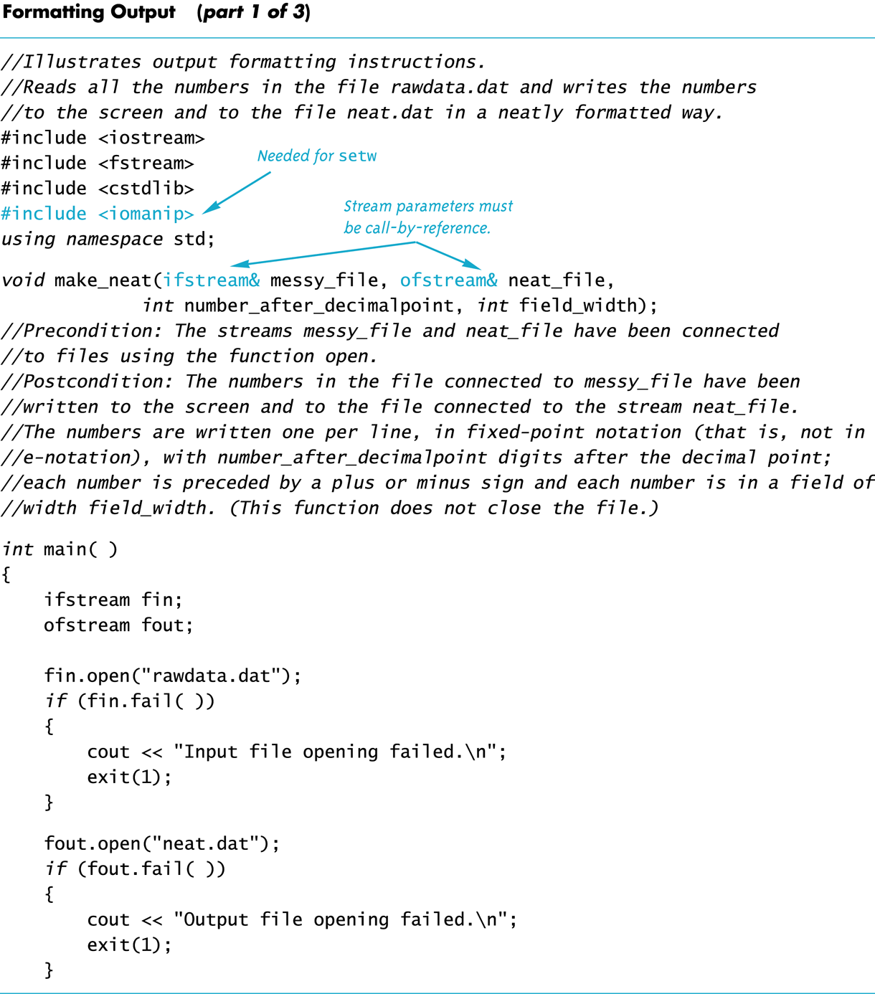
Display 6.6 (1/3)

Slide 61
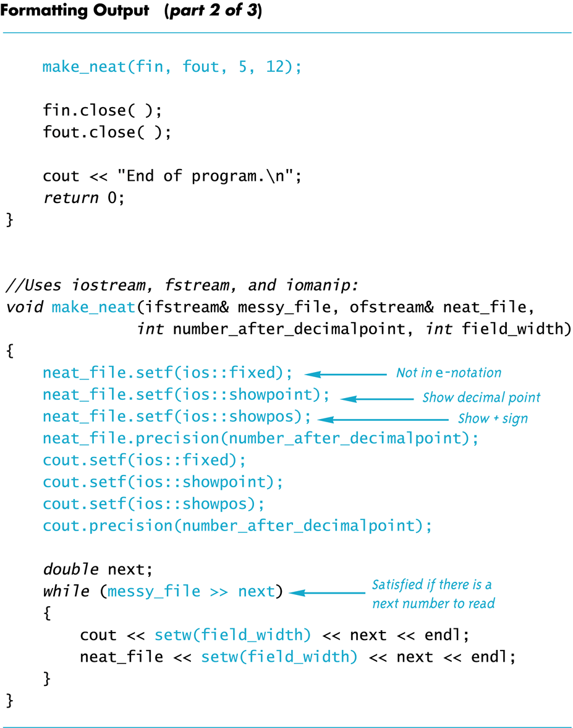
Display 6.6 (2/3)

Slide 62
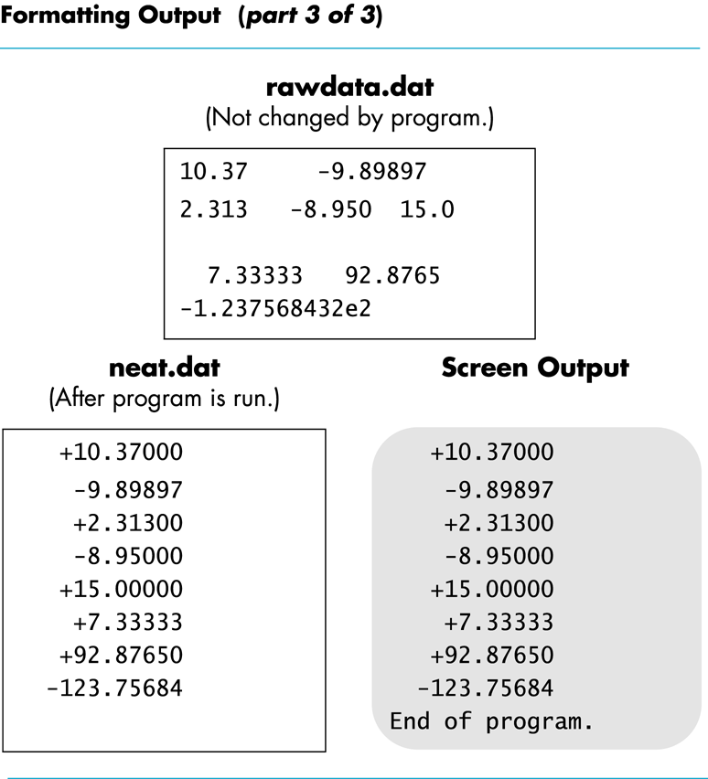
Display 6.6 (3/3)

Slide 63
Section 6.2 Conclusion
Can you
Show the output produced when the following line is executed? cout << "*" << setw(3) << 12345 << "*" endl;
Describe the effect of each of these flags? Ios::fixed ios::scientific ios::showpoint ios::right ios::right ios::showpos

Slide 64
6.3
Character I/O

Slide 65
Character I/O
All data is input and output as characters
Output of the number 10 is two characters '1' and '0'
Input of the number 10 is also done as '1' and '0'
Interpretation of 10 as the number 10 or as characters depends on the program
Conversion between characters and numbers is usually automatic

Slide 66
Low Level Character I/O
Low level C++ functions for character I/O
Perform character input and output
Do not perform automatic conversions
Allow you to do input and output in anyway you can devise

Slide 67
Member Function get
Function get
Member function of every input stream
Reads one character from an input stream
Stores the character read in a variable of type char, the single argument the function takes
Does not use the extraction operator (>>) which performs some automatic work
Does not skip blanks

Slide 68
Using get
These lines use get to read a character and store it in the variable next_symbol char next_symbol; cin.get(next_symbol);
Any character will be read with these statements
Blank spaces too!
'\n' too! (The newline character)

Slide 69
get Syntax
input_stream.get(char_variable);
Examples: char next_symbol; cin.get(next_symbol); ifstream in_stream; in_stream.open("infile.dat"); in_stream.get(next_symbol);

Slide 70
More About get
Given this code: char c1, c2, c3; cin.get(c1); cin.get(c2); cin.get(c3); and this input: AB CD
c1 = 'A' c2 = 'B' c3 = '\n'
cin >> c1 >> c2 >> c3; would place 'C' in c3 (the ">>" operator skips the newline character)

Slide 71
The End of The Line
To read and echo a line of input
Look for '\n' at the end of the input line: cout<<"Enter a line of input and I will " << "echo it.\n"; char symbol; do { cin.get(symbol); cout << symbol; } while (symbol != '\n');
All characters, including '\n' will be output

Slide 72
'\n ' vs "\n "
'\n'
A value of type char
Can be stored in a variable of type char
"\n"
A string containing only one character
Cannot be stored in a variable of type char
In a cout-statement they produce the same result

Slide 73
Member Function put
Function put
Member function of every output stream
Requires one argument of type char
Places its argument of type char in the output stream
Does not do allow you to do more than previous output with the insertion operator and cout

Slide 74
put Syntax
Output_stream.put(Char_expression);
Examples: cout.put(next_symbol); cout.put('a'); ofstream out_stream; out_stream.open("outfile.dat"); out_stream.put('Z');

Slide 75
Member Function putback
The putback member function places a character in the input stream
putback is a member function of every input stream
Useful when input continues until a specific character is read, but you do not want to process the character
Places its argument of type char in the input stream
Character placed in the stream does not have to be a character read from the stream

Slide 76
putback Example
The following code reads up to the first blank in the input stream fin, and writes the characters to the file connected to the output stream fout
fin.get(next); while (next != ' ') { fout.put(next); fin.get(next); } fin.putback(next);
The blank space read to end the loop is put back into the input stream

Slide 77
Program Example Checking Input
Incorrect input can produce worthless output
Use input functions that allow the user to re-enter input until it is correct, such as
Echoing the input and asking the user if it is correct
If the input is not correct, allow the user to enter the data again

Slide 78
Checking Input: get_int
The get_int function seen in Display 6.7 obtains an integer value from the user
get_int prompts the user, reads the input, and displays the input
After displaying the input, get_int asks the user to confirm the number and reads the user's response using a variable of type character
The process is repeated until the user indicates with a 'Y' or 'y' that the number entered is correct

Slide 79
Checking Input: new_line
The new_line function seen in Display 6.7 is called by the get_int function
new_line reads all the characters remaining in the input line but does nothing with them, essentially discarding them
new_line is used to discard what follows the first character of the the user's response to get_line's "Is that correct? (yes/no)"
The newline character is discarded as well

Slide 80
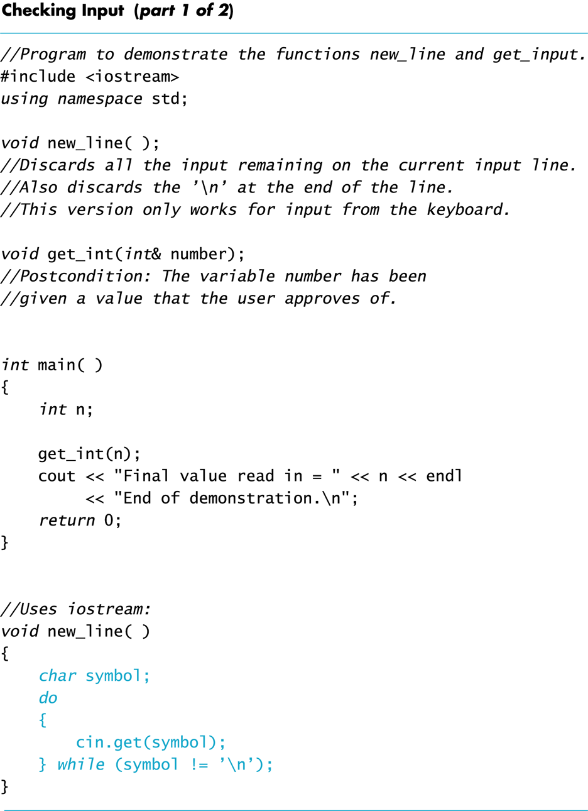
Display 6.7 (1/2)

Slide 81
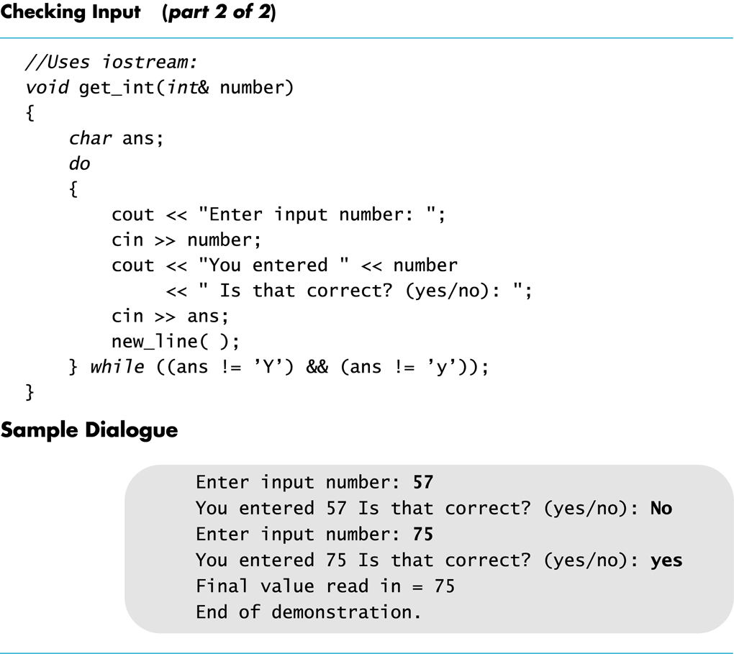
Display 6.7 (2/2)

Slide 82
Inheritance and Output
ostream is the class of all output streams
cout is of type ostream
ofstream is the class of output-file streams
The ofstream class is a child class of ostream
More about this in Chapter 10
This function can be called with ostream or ofstream arguments void say_hello(ostream& any_out_stream) { any_out_stream << "Hello"; }

Slide 83
Program Example: Another new_line Function
The new_line function from Display 6.7 only works with cin
This version works for any input stream
void new_line(istream& in_stream) { char symbol; do { in_stream.get(symbol); } while (symbol != '\n'); }

Slide 84
Program Example: Calling new_line
The new version of new_line can be called with cin as the argument new_line(cin);
If the original version of new_line is kept in the program, this call produces the same result new_line( );
New_line can also be called with an input-file stream as an argument new_line(fin);

Slide 85
Default Arguments
It is not necessary to have two versions of the new_line function
A default value can be specified in the parameter list
The default value is selected if no argument is available for the parameter
The new_line header can be written as new_line (istream & in_stream = cin)
If new_line is called without an argument, cin is used

Slide 86
Multiple Default Arguments
When some formal parameters have default values and others do not
All formal parameters with default values must be at the end of the parameter list
Arguments are applied to the all formal parameters in order just as we have seen before
The function call must provide at least as many arguments as there are parameters without default values

Slide 87
Default Argument Example
void default_args(int arg1, int arg2 = -3) { cout << arg1 << ' ' << arg2 << endl; }
default_args can be called with one or two parameters
default_args(5); //output is 5 -3
default_args(5, 6); //output is 5 6

Slide 88
Checking Input: Check for Yes or No?
get_int continues to ask for a number until the user responds 'Y' or 'y' using the do-while loop do { // the loop body } while ((ans !='Y') &&(ans != 'y') )
Why not use ((ans =='N') | | (ans == 'n') )?
User must enter a correct response to continue a loop tested with ((ans =='N') | | (ans == 'n') )
What if they mis-typed "Bo" instead of "No"?
User must enter a correct response to end the loop tested with ((ans !='Y') &&(ans != 'y') )

Slide 89
Mixing cin >> and cin.get
Be sure to deal with the '\n' that ends each input line if using cin >> and cin.get
"cin >>" reads up to the '\n'
The '\n' remains in the input stream
Using cin.get next will read the '\n'
The new_line function from Display 6.7 can be used to clear the '\n'

Slide 90
'\n' Example
The Dialogue: Enter a number: 21 Now enter a letter: A
The Code: cout << "Enter a number:\n"; int number; cin >> number; cout << "Now enter a letter:\n"; char symbol; cin.get(symbol);
The Result:
number = 21
symbol = '\n'

Slide 91
A Fix To Remove '\n'
cout << "Enter a number:\n"; int number; cin >> number; cout << "Now enter a letter:\n"; char symbol; cin >>symbol;

Slide 92
Another '\n' Fix
cout << "Enter a number:\n"; int number; cin >> number; new_line( ); // From Display 6.7 cout << "Now enter a letter:\n"; char symbol; cin.get(symbol);

Slide 93
Detecting the End of a File
Member function eof detects the end of a file
Member function of every input-file stream
eof stands for end of file
eof returns a boolean value
True when the end of the file has been reached
False when there is more data to read
Normally used to determine when we are NOT at the end of the file
Example: if ( ! in_stream.eof( ) )

Slide 94
Using eof
This loop reads each character, and writes it to the screen
in_stream.get(next); while (! in_stream.eof( ) ) { cout << next; in_stream.get(next); }
( ! In_stream.eof( ) ) becomes false when the program reads past the last character in the file

Slide 95
The End Of File Character
End of a file is indicated by a special character
in_stream.eof( ) is still true after the last character of data is read
in_stream.eof( ) becomes false when the special end of file character is read

Slide 96
How To Test End of File
We have seen two methods
while ( in_stream >> next)
while ( ! in_stream.eof( ) )
Which should be used?
In general, use eof when input is treated as text and using a member function get to read input
In general, use the extraction operator method when processing numeric data

Slide 97
Program Example: Editing a Text File
The program of Display 6.8…
Reads every character of file cad.dat and copies it to file cplusad.dat except that every 'C' is changed to "C++" in cplusad.dat
Preserves line breaks in cad.dat
get is used for input as the extraction operator would skip line breaks
get is used to preserve spaces as well
Uses eof to test for end of file

Slide 98
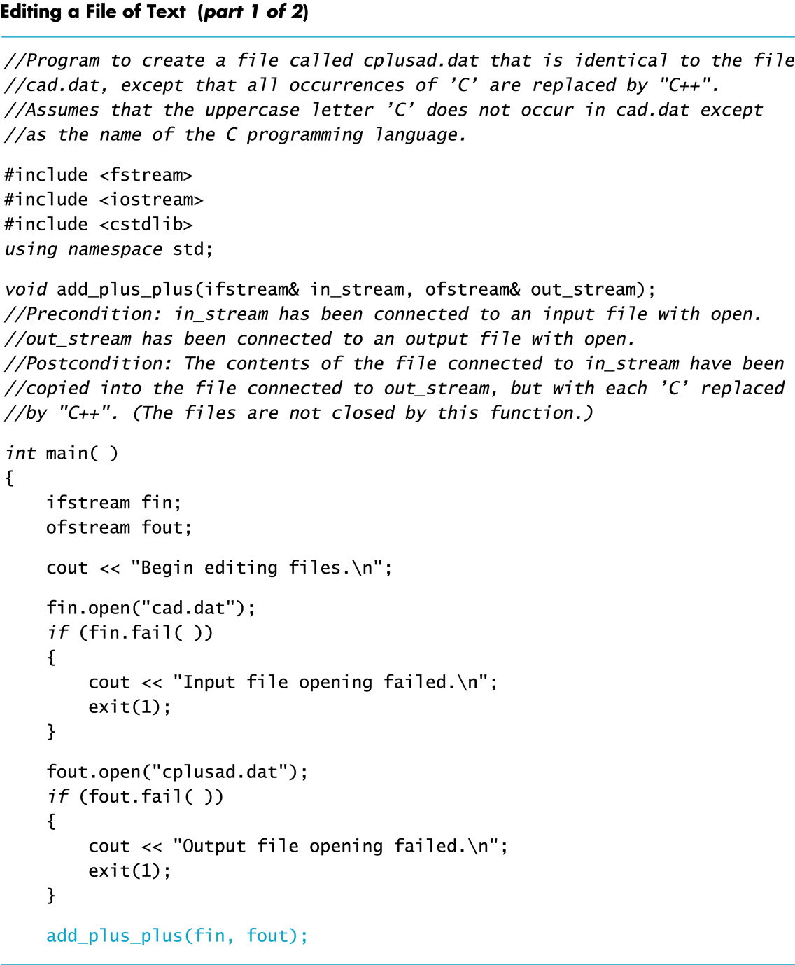
Display 6.8 (1/2)

Slide 99
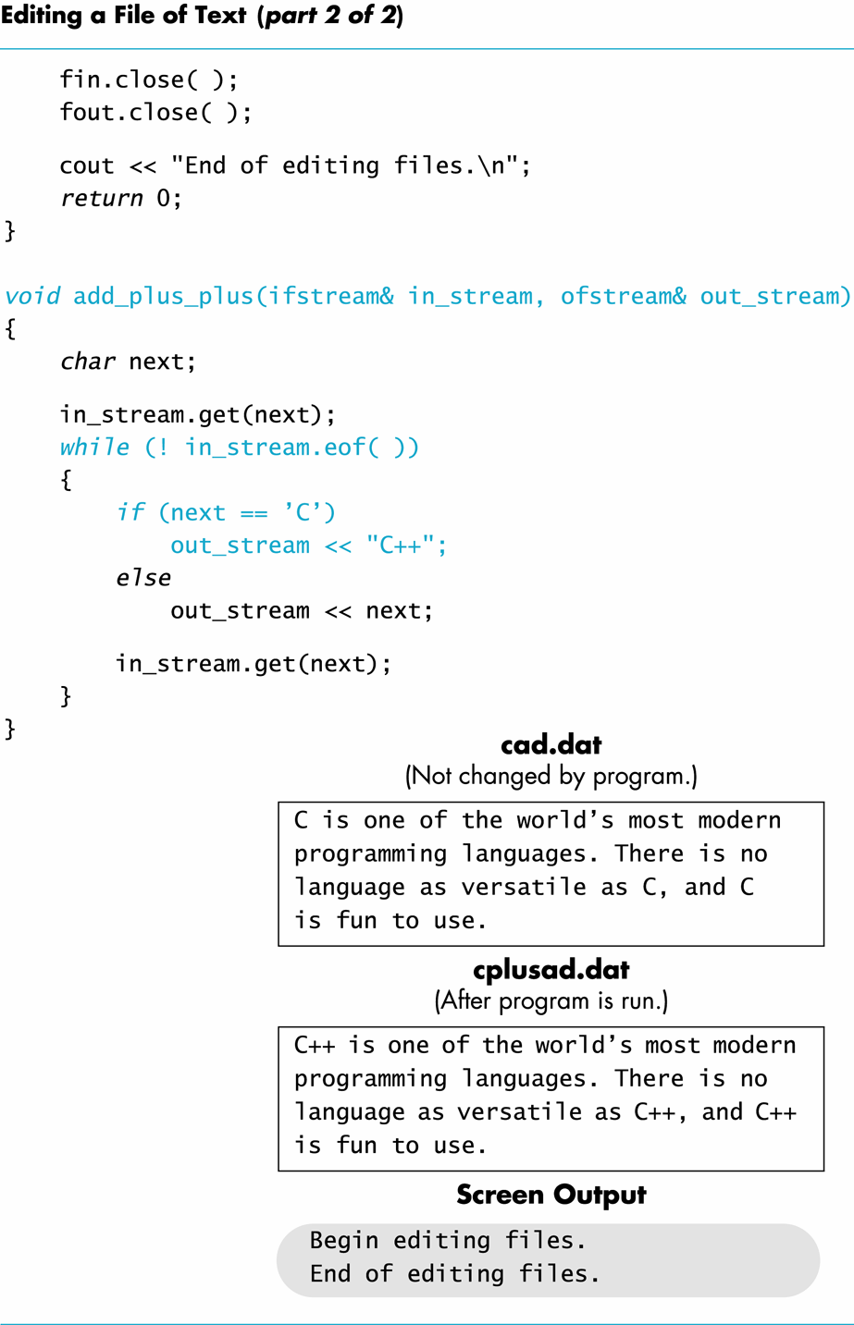
Display 6.8 (2/2)

Slide 100
Character Functions
Several predefined functions exist to facilitate working with characters
The cctype library is required
#include <cctype> using namespace std;

Slide 101
The toupper Function
toupper returns the argument's upper case character
toupper('a') returns 'A'
toupper('A') return 'A'

Slide 102
toupper Returns An int
Characters are actually stored as an integer assigned to the character
toupper and tolower actually return the integer representing the character
cout << toupper('a'); //prints the integer for 'A'
char c = toupper('a'); //places the integer for 'A' in c cout << c; //prints 'A'
cout << static_cast<char>(toupper('a')); //works too

Slide 103
The isspace Function
isspace returns true if the argument is whitespace
Whitespace is spaces, tabs, and newlines
isspace(' ') returns true
Example: if (isspace(next) ) cout << '-'; else cout << next;
Prints a '-' if next contains a space, tab, or newline character
See more character functions in

Slide 104
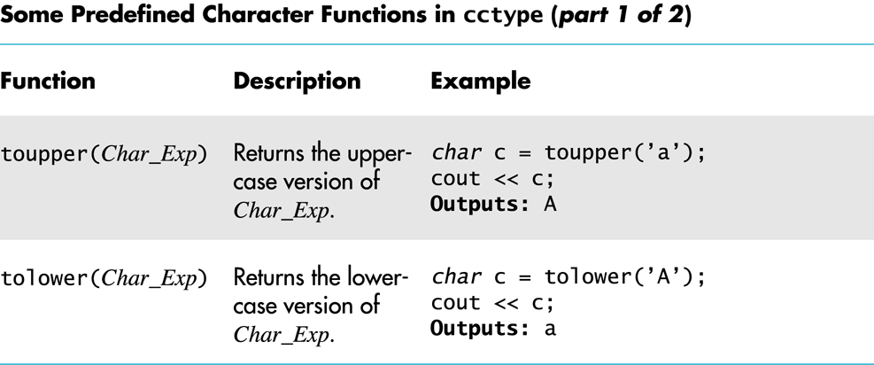
Display 6.9 (1/2)

Slide 105
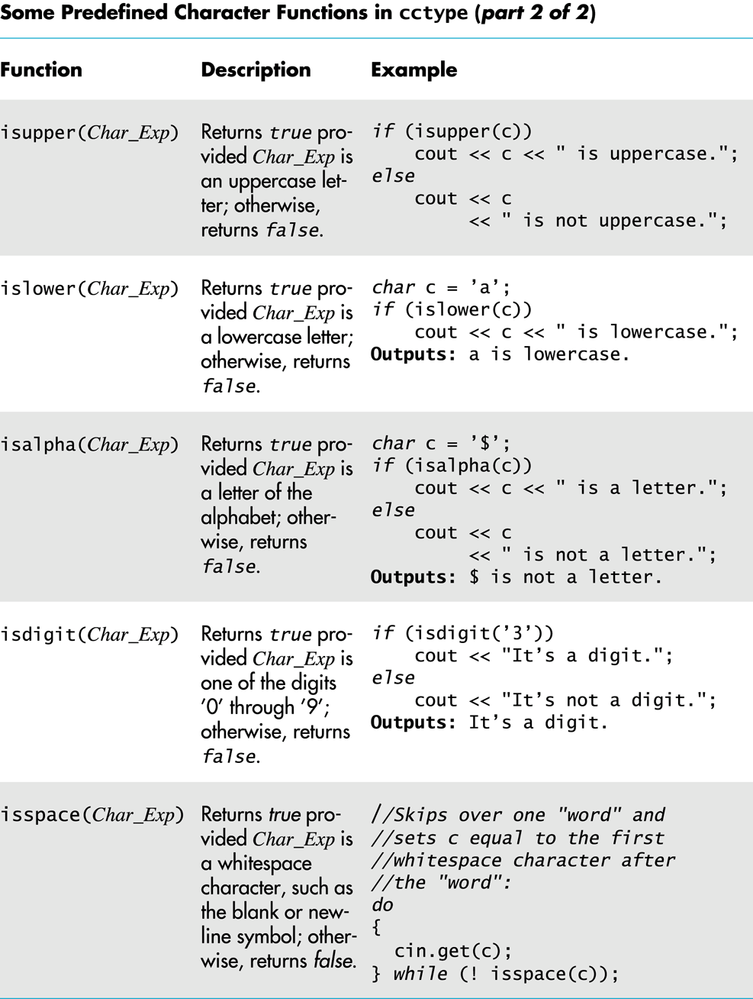
Display 6.9 (2/2)

Slide 106
Section 6.3 Conclusion
Can you
Write code that will read a line of text and echo the line with all the uppercase letters deleted?
Describe two methods to detect the end of an input file:
Describe whitespace?

Slide 107
Chapter 6 -- End

